Slide 1


Online Experiments for Language Scientists
Kenny Smith
kenny.smith@ed.ac.uk
These slides are based on Shira Tal & Kenny Smith, “A brief introduction to running artificial language learning experiments online”, Edinburgh Workshop on Artificial Language Learning, October 2021

Slide 2
This is mainly a pointer to other resources
These slides and code are available online for more leisurely perusal
https://github.com/kennysmithed/oels_emlar2023
Lots of more detailed materials on my Edinburgh undergrad/Masters course page!
2022 iteration: https://kennysmithed.github.io/oels2022/
Longer lecture slides and detailed notes on crowdsourcing etc
Example code for linguistics experiments of various complexities
Linguistics undergrad/MSc students who can’t code all produce a working experiment by the end of the course – so you can learn too

Slide 3
Why run experiments online?
Pandemics!
Faster
Larger samples
Potentially more diverse populations (less WEIRD)
Access to specific populations

Slide 4
Challenges moving to online data collection
(For some of us): It’s new
Involves more components to take care of
(Could) involve more coding
Less control:
Who are the participants?
In what environment do they participate in the study?

Slide 5
Running experiments in the lab
Recruiting participants (for me, mainly university students)
Participants do the experiment in the lab

Slide 6

Running experiments in the lab
Various ways to recruit participants to come into the lab (SONA, advertising on campus…)
Programming environment to create the experiment (PsychoPy, Eprime…)
Supporting files & data are saved on the lab’s computer

Slide 7

Running experiments online
Participants are recruited to do experiments on their own devices
Programming environment to create the experiment (so it is presented on participants’ devices)
Supporting files & data are saved outside of participants’ devices

Slide 8
Running experiments online
Platforms to recruit and compensate participants (Prolific, Mechanical Turk…)
Programming environment to create the experiment (javascript, jsPsych, Gorilla…)
Server
(university or private server, Pavlovia, cognition.run, …)

Slide 9
Overview of this tutorial
Platforms to recruit and compensate participants (Prolific, Mechanical Turk…)
Programming environment to create the experiment (javascript, jsPsych, Gorilla…)
Server
(university or private server, Pavlovia, cognition.run, …)

Slide 10
Recruiting participants online
Notes:
Mainly adults, trickier with kids!

Slide 11



Crowdsourcing
Once an experiment runs on a browser, it can be potentially sent to anyone with an internet connection
Crowdsourcing sites
Designed for crowdsourcing anything
Designed for scientific data collection

Slide 12
Update prolific screenshots and references later

Slide 13
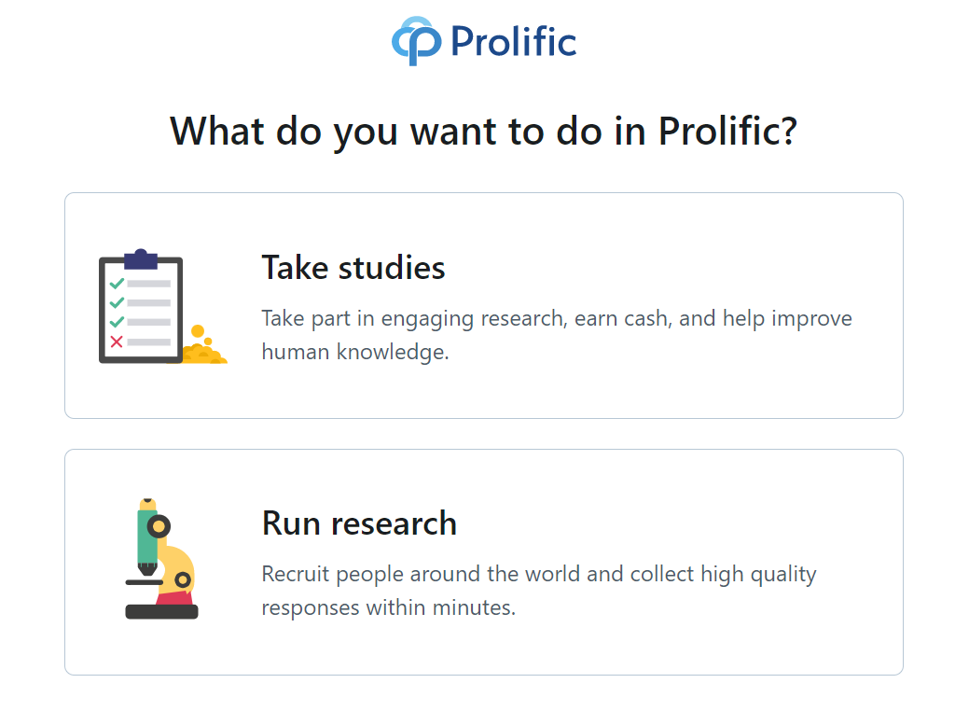
A quick look at Prolific

Slide 14
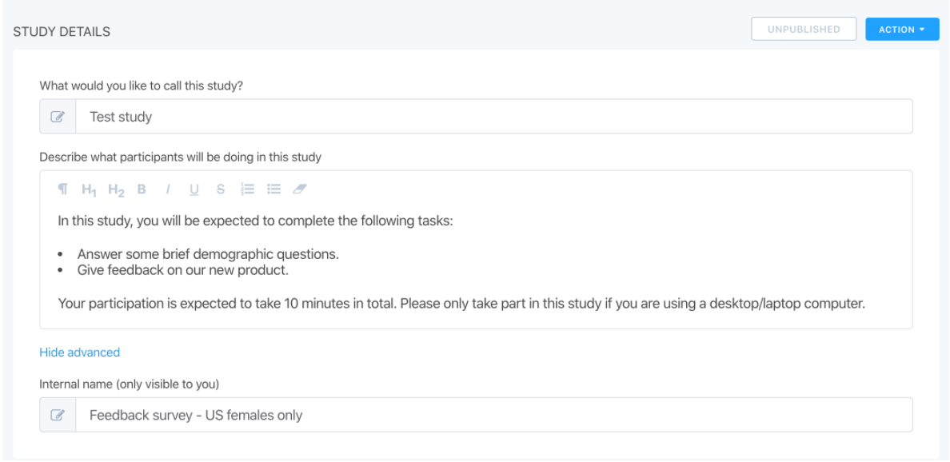
A quick look at Prolific

Slide 15
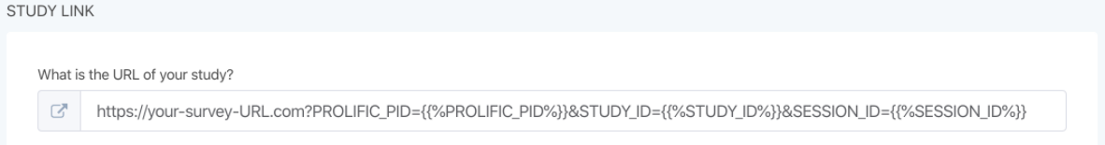
A quick look at Prolific
Adding a link to the actual study

Slide 16
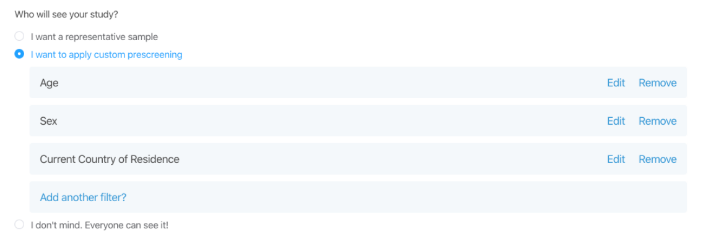
A quick look at Prolific
Targeting a specific audience

Slide 17
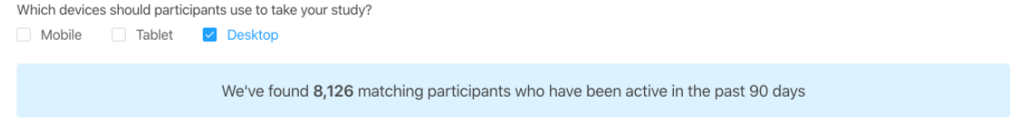
A quick look at Prolific
Targeting a specific audience

Slide 18
Recruiting children for online studies
We (actually it was Shira Tal) have done this precisely once!
Older kids (age 5-6) recruited through our participant pool
Zoom call with screen sharing and an experiment coded in jsPsych
Quick compared to lab data collection
There are crowdsourcing sites for child participants
https://childrenhelpingscience.com (now merged with lookit)
https://lookit.mit.edu (mainly preferential looking, using their own jsPsych-like framework)
Notes:
For older kids, I think a sufficiently well-designed experiment could be run by themselves, with parental help at the start

Slide 19
Data quality
Are participants who they say they are?
Actual humans
Language proficiency
Age
Are they paying attention?
Multi-tasking
Randomly responding
Online experiments need to be designed to handle this, and these problems can be reduced with good design (I think)

Slide 20
Data quality
Design for an audience who have other demands on their time!
Make the experiment as short and fun as possible
Pilot before starting collecting data for real!
Build in checks for the things you care about
Language tests (will need to be AI proof!)
Attention checks (Prolific specifies what counts as “fair”)
Make random clicking annoying for participants
Make them repeat a trial during training when they get it wrong
Make pauses after wrong answers longer
Debrief to find out how people are doing the task

Slide 21
Ethics
Online studies are not cheaper than lab studies because they involve both compensation for participants and a platform fee to Prolific/MTurk
Mturk has no minimum pay rate
Prolific has a cheap minimum pay rate (£5/hour)
But exploiting people for low pay is unethical – we pay fairly at least the National Minimum Wage
Pilot before starting
If things break or take a lot longer than advertised, participants get stressed
Treat participants with respect

Slide 22
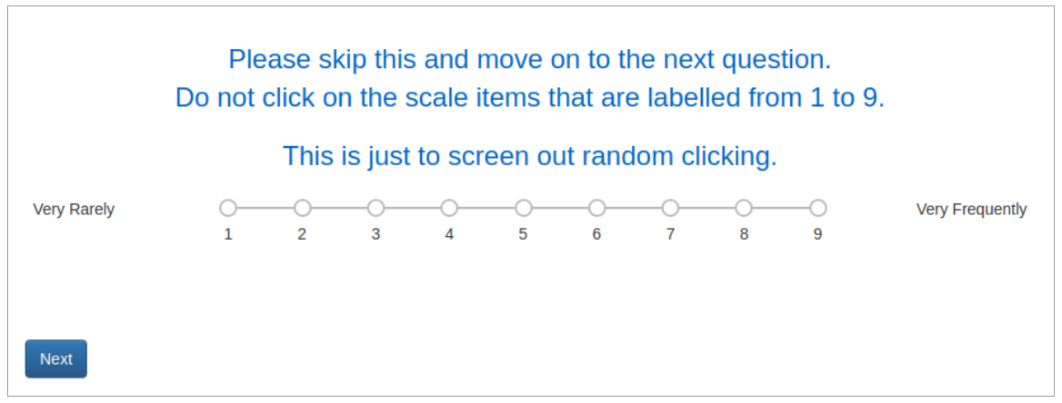
Data quality
(Oppenheimer, Meyvis, & Davidenko, 2009; Psychstudio, 2019)

Slide 23
Pros and cons of crowdsourcing experimental data
Pros
Not face-to-face
Large samples, fast
Access different populations
+ for replicability
Cons
Expensive (not cheap)
Lack of control
Encourages dumb experiments?
- for replicability

Slide 24
Comparability with lab data
Do effects of lab-studies replicate online?
Is the lab data the “gold standard” or simply the only data available?
More variation coming from more noise, or more diverse participants?
Effects of many paradigms first tested in the lab were replicated with crowdsourced populations (e.g., Monroe et al., 2010; Stewart et al., 2017)
Including for artificial language learning (e.g., Fedzechkina & Jaeger, 2020; Roberts & Fedzechkina, 2018; Smith & Culbertson, 2020)

Slide 25
Building online experiments using javascript and jsPsych

Slide 26
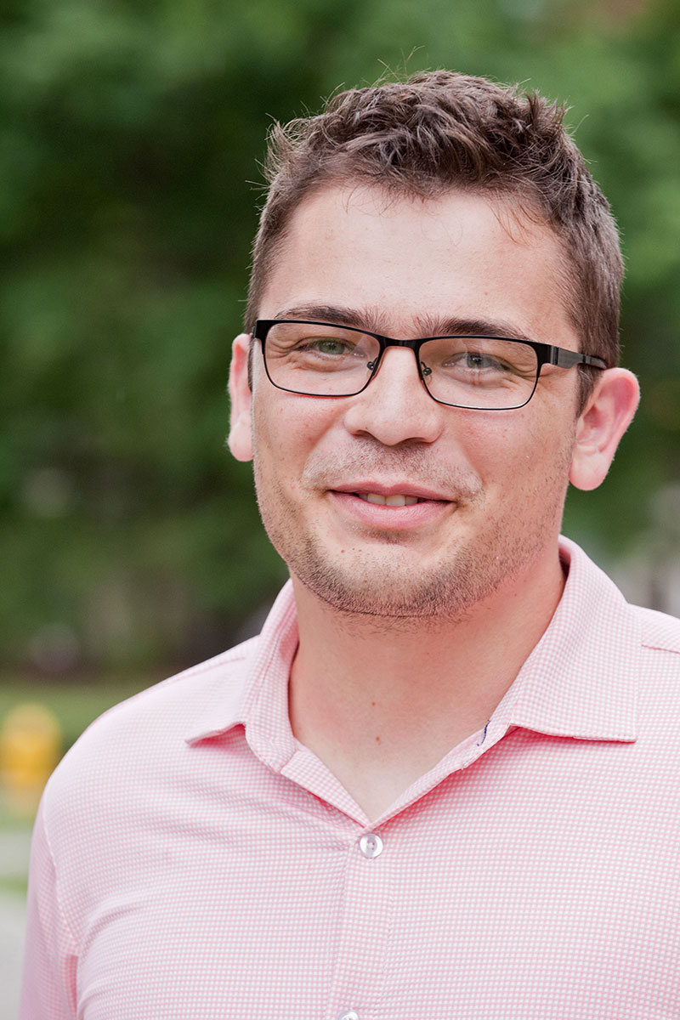
Javascript and jsPsych
Javascript: a programming language that runs in web browsers
jsPsych: a library that makes it easy to build experiments (https://www.jspsych.org)
de Leeuw, J. R. (2015). jsPsych: A JavaScript library for creating behavioral experiments in a web browser. Behavior Research Methods, 47, 1-12. doi:10.3758/s13428-014-0458-y.
Josh de Leeuw
Vassar College

Slide 27
Resources for teaching yourself jsPsych
My course: https://kennysmithed.github.io/oels2022/
The main jsPsych webpage: https://www.jspsych.org
Josh de Leeuw’s tutorials at Moving Research Online workshop, 2020: https://www.movingresearchonline.info
jsPsych discussion forum on github: https://github.com/jspsych/jsPsych/discussions
Plus for general javascript help, googling until you find an answer you can use on StackOverflow!

Slide 28
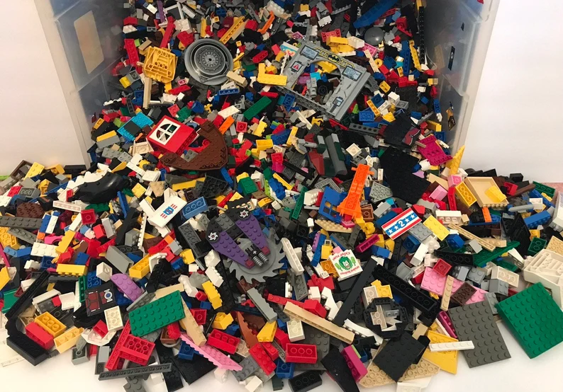
Notes:
Plugins and timelines

Slide 29
Plugins and timelines
Plugins: basic building blocks
Timeline: a sequence of those building blocks
Notes:
This is from the hello world example in the jsPsych starter tutorial

Slide 30
A wide range of plugins available
See https://www.jspsych.org/7.3/plugins/list-of-plugins/
Building an experiment involves
Knowing how to use plugins
Figuring out how to piece them together
Some tiny bits of html and javascript to connect the plugins and make them do what you want
(Occasionally, and optionally, making your own plugin)
Massive reuse of code within and across experiments!

Slide 31
Common components of experiments I build (usually artificial language learning tasks)
1. Consent and instructions
Minimally, some text + a button click
2. Training
Stimuli can be images, text, sounds
Entirely passive, or responses required to maintain engagement?
3. Test
Stimuli can be images, text, sounds
Responses required: button clicks, key presses, spoken responses
4. Demographics/additional info
Radio buttons, drop-down menus, numbers, free-text comments, …

Slide 32
A simple frequency-learning experiment
Ferdinand, V., Kirby, S., & Smith, K. (2019). The cognitive roots of regularization in language. Cognition, 184, 53-68.
(Code: https://kennysmithed.github.io/oels2020/oels_practical_wk6.html)
Under what conditions do participants accurately track frequency distributions in their input, and when do they regularize (over-use frequent variants)?
Standard paradigm in the artificial language learning literature, e.g. Hudson Kam & Newport, 2005; Vouloumanos, 2008; Reali & Griffiths, 2009; Smith & Wonnacott, 2010; Culbertson et al., 2012; …
We were interested in effects of domain (linguistic vs non-linguistic stimuli) and demand (number of frequency distributions you have to track)

Slide 33
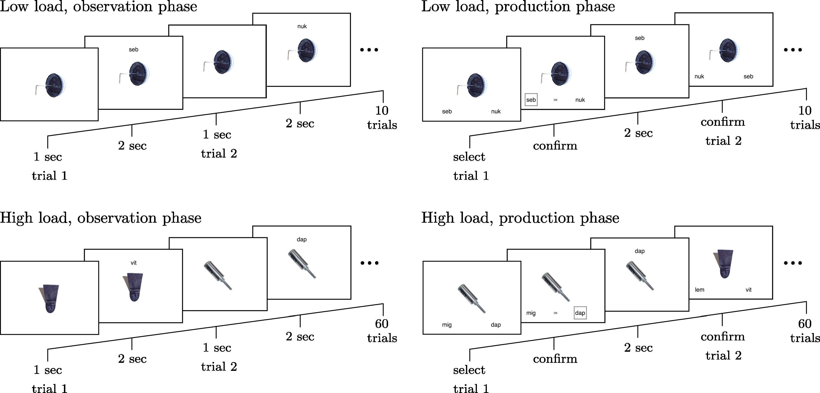
Notes:
I can see I have to present an image plus some text in observation trials. In production trials, I have to present an image plus two buttons. image-button-response plugin will allow me to do all of this.

Slide 35
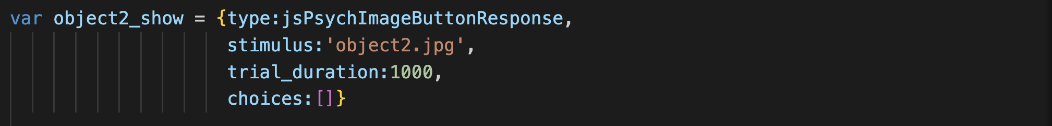
Using an ImageButtonResponse plugin to show image

Slide 36
This specific image is called object2.png

Slide 37
Show it for 1000ms

Slide 38
No response required!

Slide 39
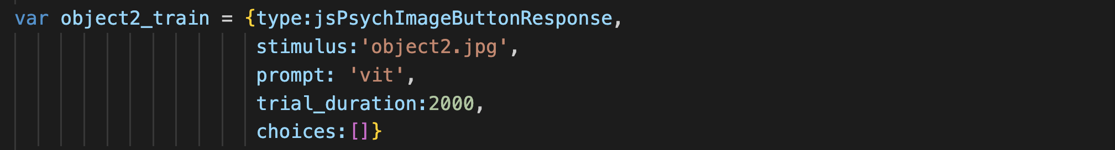
Using an image-button-response plugin to show image

Slide 40
This specific image is called object2.png

Slide 41
Show it along with label using the prompt parameter

Slide 42
Show it for 2000ms

Slide 43
No response required!

Slide 44
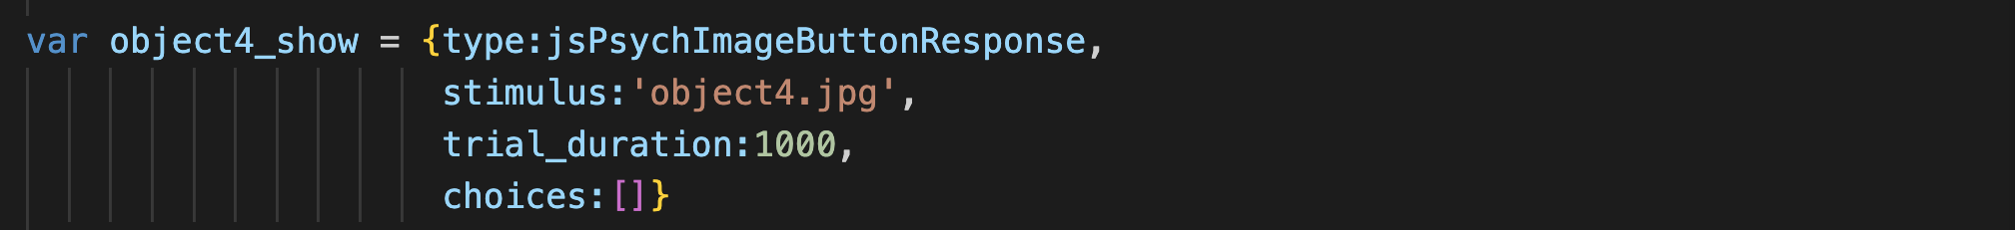
Show (different) image

Slide 45
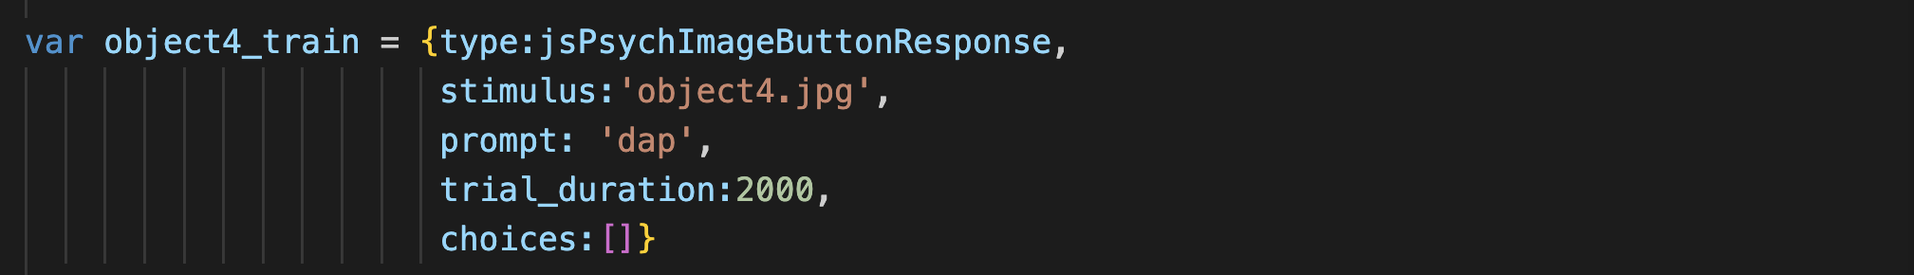
Show (different) image + label

Slide 46
String many trials together to form a timeline

Slide 47
Notes:
OK, so this is going to be the same idea, and I can already see that I can re-use something – the post-confirmation display phase is exactly like the labelling trials during training, so I can re-use code there. But now I will be adding in choices. And a tricky thing – what I show during the post-confirmation display will depend on what they clicked on - *contingent trials*, very typical in experiments involving any kind of feedback.

Slide 48
Using an image-button-response plugin to show image and get response

Slide 49
choices parameter contains labels for buttons

Slide 50
Note we no longer specify the trial duration: trial lasts until the participant responds

Slide 51
Confirm trial: going to do this slightly differently and make them click on a button showing the label they just selected

Slide 52
dap
Confirm trial: going to do this slightly differently and make them click on a button showing the label they just selected

Slide 53
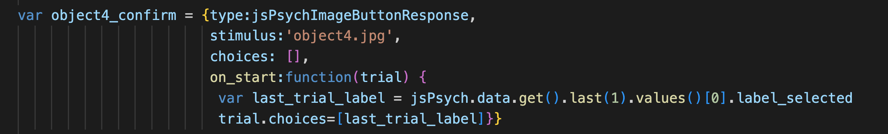
dap
When we build the timeline (i.e. when the experiment is loaded), we don’t know what the confirmation label will be!

Slide 54
dap
But by the time this trial starts, we can retrieve it…

Slide 55
dap
…by consulting the data generated by the immediately preceding trial

Slide 56
dap
That will be the label for our confirmation button

Slide 57
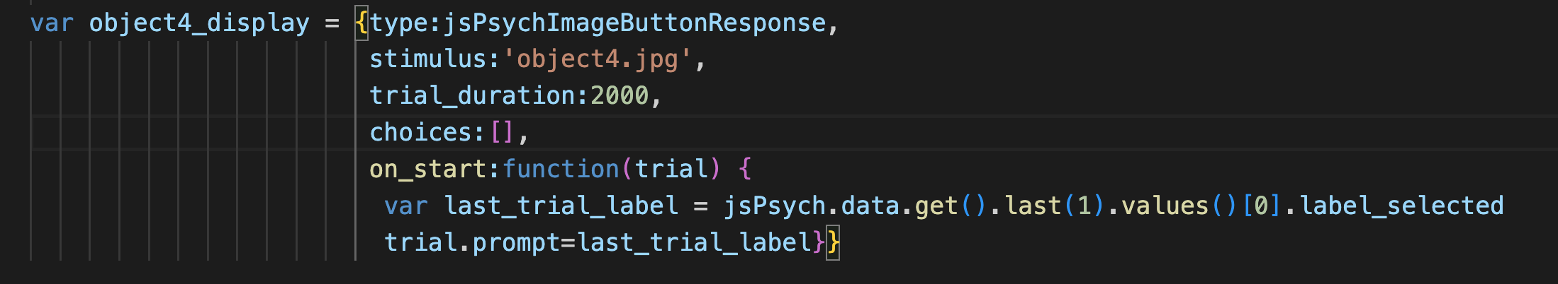
dap
Post-confirmation display looks like a training trial…

Slide 58
dap
…except we use the same trick to get the prompt from their previous trial response

Slide 60
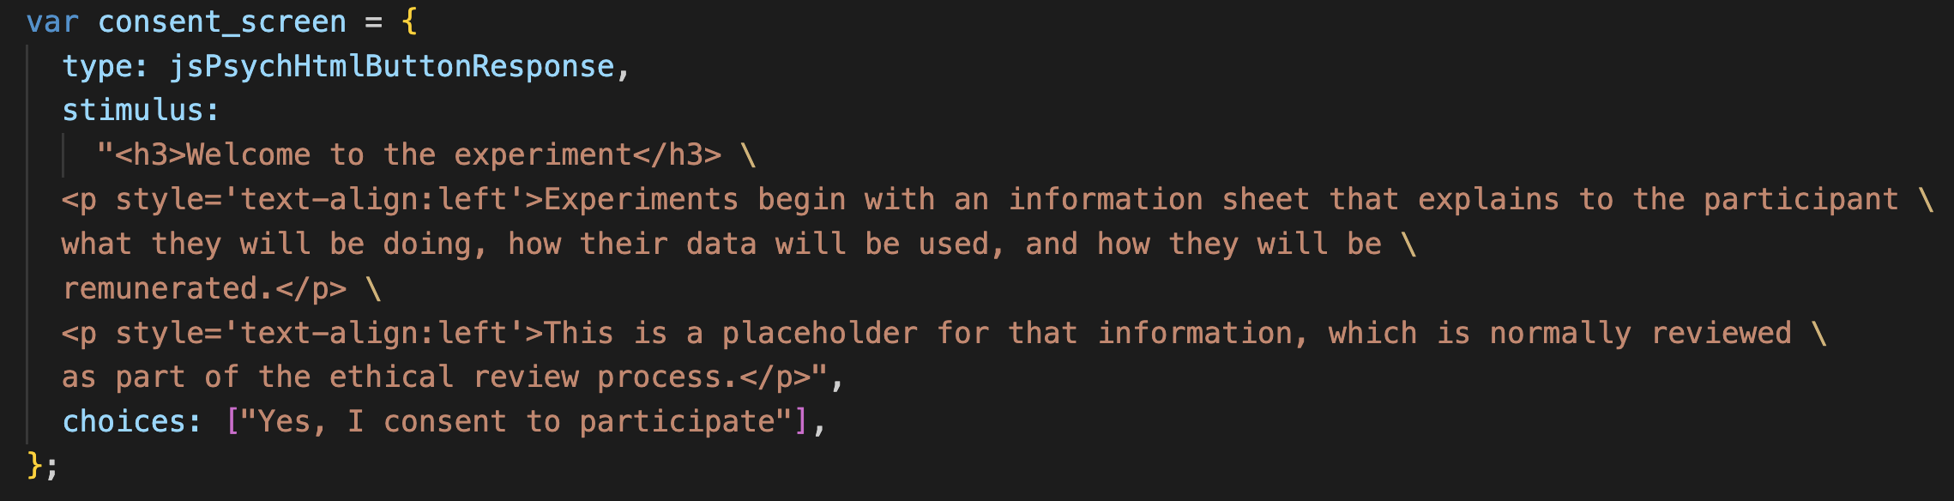
Using an html-button-response plugin to show formatted text and get them to click
Notes:
*definitely* going to need a consent screen

Slide 61
The “stimulus” is the text that will appear on the screen.
(I have added some formatting to make it look nice)

Slide 62
Here there is only one choice, which is to consent

Slide 64
survey-html-form allows you to collect various kinds
of responses on a single screen

Slide 65
Demo – ferdinand_etal_2019/fks19.html

Slide 66
An example involving audio stimuli and keyboard responses
Based on Gomez, R. L. & Gerken, L. (1999) Artificial grammar learning by 1-year-olds leads to specific and abstract knowledge. Cognition, 70, 109-135.
Can participants implicitly learn an underlying grammar from presentation of positive examples, and subsequently differentiate between strings generated by / not generated by that grammar?
Standard paradigm in the artificial grammar learning literature, e.g. Reber, 1967, 1989; Wilson et al., 2015; …
audio-keyboard-response plugin to present word sequences during training (NB no response required)
html-keyboard-response plugin to obtain yes/no responses on test trials

Slide 67
Demo – gomez_gerken_1999/gg99.html

Slide 68
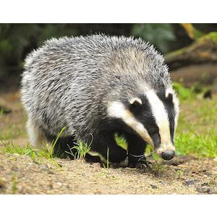


An unexpected challenge: multimodal stimuli
Previous examples were quite easy to achieve using existing plugins
But what if there isn’t a plugin that does exactly what you want? E.g. image and audio on a single trial
Two options:
Smuggle in images to the prompt on an audio-button-response trial, or smuggle in audio to the prompt on an image-button response trial
Edit the plugin to produce a custom plugin, e.g. an image-audio-button-response plugin!
Click to listen
Notes:
Not as hard as it sounds – and you can also use this to make superficial changes, add extra text fields, make a 2-image plugin, etc

Slide 69
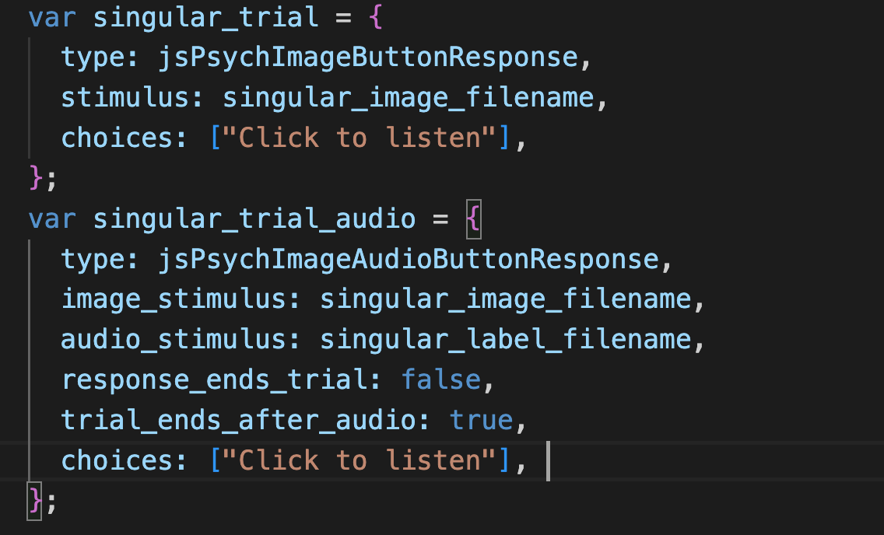
An unexpected challenge: multimodal stimuli
Click to listen
Notes:
Not as hard as it sounds – and you can also use this to make superficial changes, add extra text fields, make a 2-image plugin, etc

Slide 70
Demo – martin_white_2021/mw21.html

Slide 71
Additional things you will want to know how to do
Random assignment to conditions
Preloading stimuli
Saving data
Recording audio responses
Reading in trial lists
Contingent progression

Slide 72
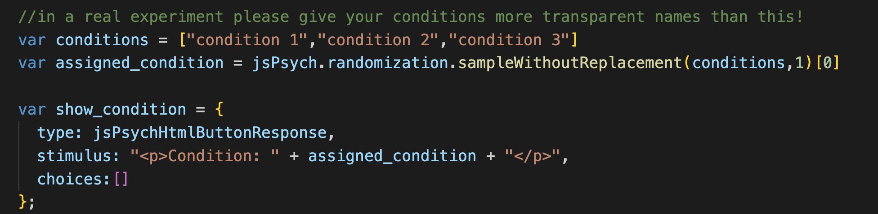
Random assignment to conditions

Slide 73
Demo – other_examples/random_assignment.html

Slide 74
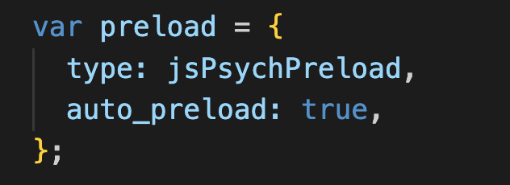
Preloading stimuli
Downloading images, sound files etc takes an unpredictable amount of time.
Trial durations ignore the time taken to download
And beware: if you are testing your code, your browser might already have loaded and cached the stimuli, so you won’t notice the lag
The solution: preloading
Requires you to use the preload plugin
Certain plugins mark parameters (e.g. stimuli) for automatic preloading by the preload plugin
You can add everything else to a manual preload list
See jsPsych pages on preloading: https://www.jspsych.org/7.3/overview/media-preloading/

Slide 75
Saving data
You need to save data on your server, not on the participant’s computer!
Requires a bit of extra infrastructure: PHP script to write data to server (and a server that can run PHP)
See e.g.
jsPsych pages on data: https://www.jspsych.org/7.3/overview/data/
Week 6+ of my course (e.g. https://kennysmithed.github.io/oels2022/oels_practical_wk6.html)
You can save data at the end of the experiment or after every trial
Do trial-by-trial if you can!

Slide 76
Recording audio responses
Accessing a participants’ microphone (and camera!) is quite straightforward
Although they have to approve, so you need to warn them you will request access
Recording audio data involves a little bit of extra work
Another PHP script to save the audio data to your server
See week 8 of my course: (https://kennysmithed.github.io/oels2022/oels_practical_wk8.html)
Audio quality varies, and sometimes the quality progressively degrades, but you get decent audio from 95% of participants

Slide 77
Reading in trial lists
I usually generate trial lists on the fly in the experiment code
e.g. using a jsPsych.randomization.repeat, or a for-loop
If you prefer to have the trial list in a separate file on the server, that’s possible too
Reading in CSV files is slightly tricky because it involves a delay in accessing a file on the server (you have to force the browser to wait until the trial list is loaded)
See weeks 8-10 of my course (https://kennysmithed.github.io/oels2022/oels_practical_wk8.html)

Slide 78
Contingent progression
Useful to be able to control who progresses beyond a certain point in your experiment
See https://www.jspsych.org/7.3/overview/timeline/#conditional-timelines
(Martin & White, 2021, p. 229-230)
Notes:
Show them the conditionals example

Slide 79
Demo – other_examples/contingent_progression.html

Slide 80
Other platforms are available!
Flexible
Inflexible
Qualtrics
Gorilla
Psychopy3
Raw
javascript
jsPsych
Difficult
Easy

